Slide 1
The MetroHealth System’s Institute for H.O.P.E.TM

Slide 2
The Institute for H.O.P.E. ™
Improved Health through Opportunity, Partnership and Empowerment
Improve the health of populations by leading efforts to address social and economic barriers to good health
Identify and promote opportunities for change in practice, learning and policy
Develop and nurture partnerships to make the greatest impact for individuals, neighborhoods and communities
Co-create a self-sustaining community where everyone is empowered to live their healthiest life

Slide 3
SDOH Screening Domains:
Food Insecurity
Physical Activity
Digital Connectivity
Financial Resource Strain
Employment Status
Social Isolation
Housing Stability
Stress
Education
Intimate Partner Violence
Transportation

Slide 4
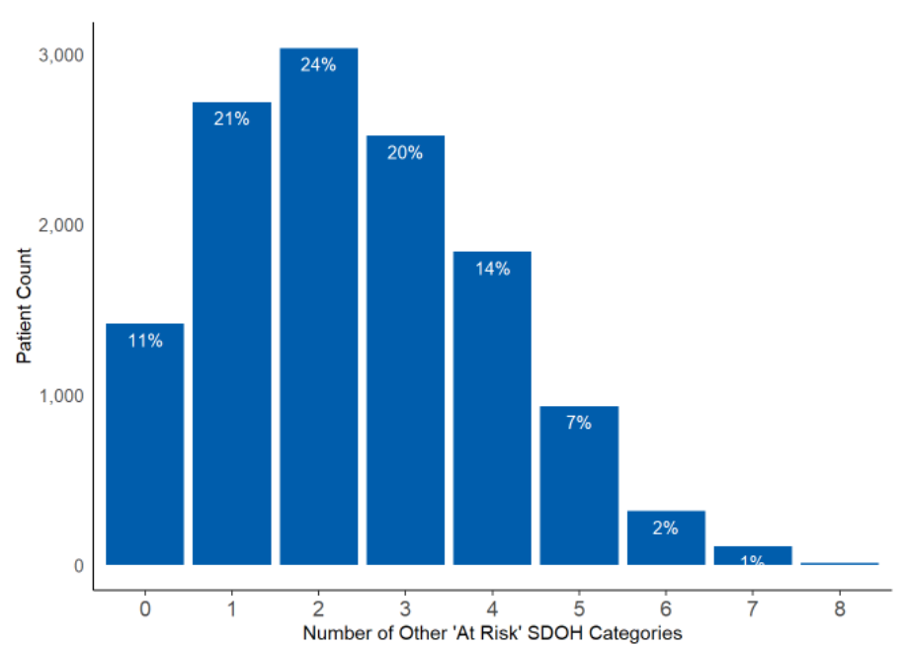
Deep Dive: Food Insecurity
 | Total Risk | Black / African American | White | Hispanic
At Risk | 13,583 (21%) | 6,506 (29%) | 5,582 (15%) | 1,702 (31%)
Not At Risk | 51,821 (79%) | 15,598 (71%) | 31,838 (85%) | 3,746 (69%)
Total | 65,404 | 22,104 | 37,420 | 5,448
11.7x More Likely
Financial Resource Strain
44% have 3 or more other risks
3.4x More Likely
Transportation
Housing Stability
3.0x More Likely
Intimate Partner Violence
1.9x More Likely

Slide 5
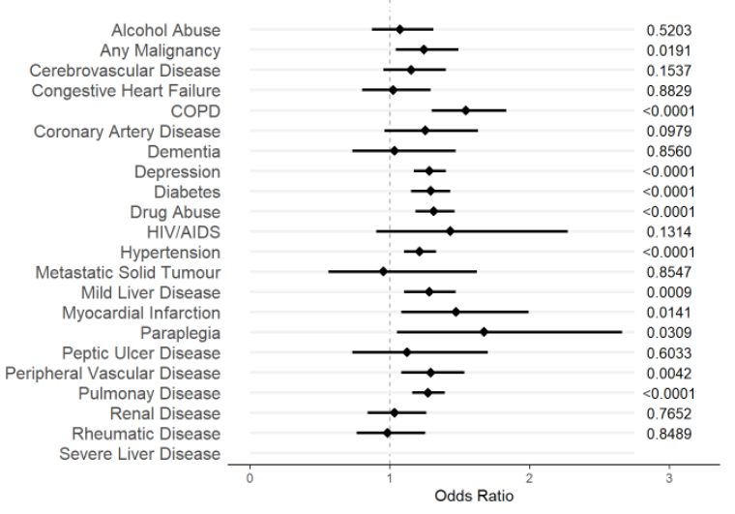
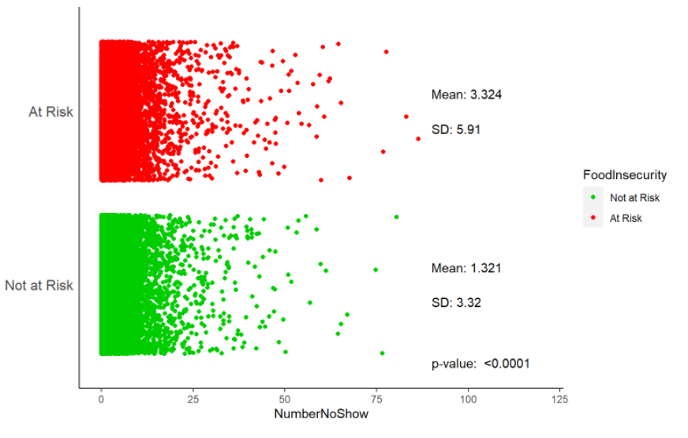
Deep Dive: Food Insecurity
25% More Likely
3 or more ED visits
62% More Likely
10 or more ED visits

Slide 6
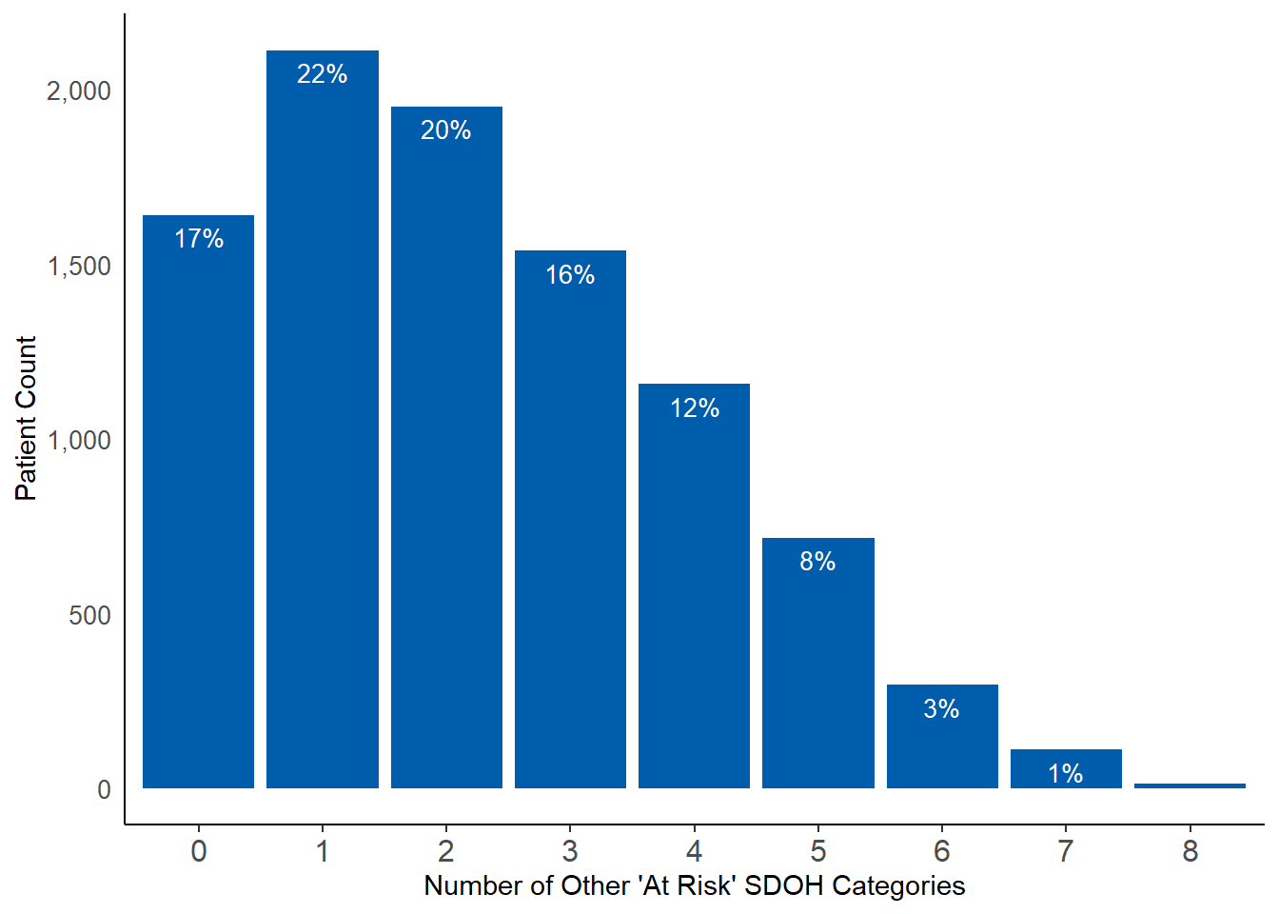
Deep Dive: Housing Instability
 | Total Risk | Black / African American | White | Hispanic
At Risk | 10,136 (21%) | 4,578 (31%) | 4,503 (15%) | 1,039 (27%)
Not At Risk | 38,676 (79%) | 10,035 (69%) | 25,133 (85%) | 2,833 (73%)
Total | 48,812 | 14,613 | 29,636 | 3,872
4.4x More Likely
Financial Resource Strain
40% have 3 or more other risks
3.0x More Likely
Food Insecurity
Transportation
2.6x More Likely
Intimate Partner Violence
1.9x More Likely

Slide 7
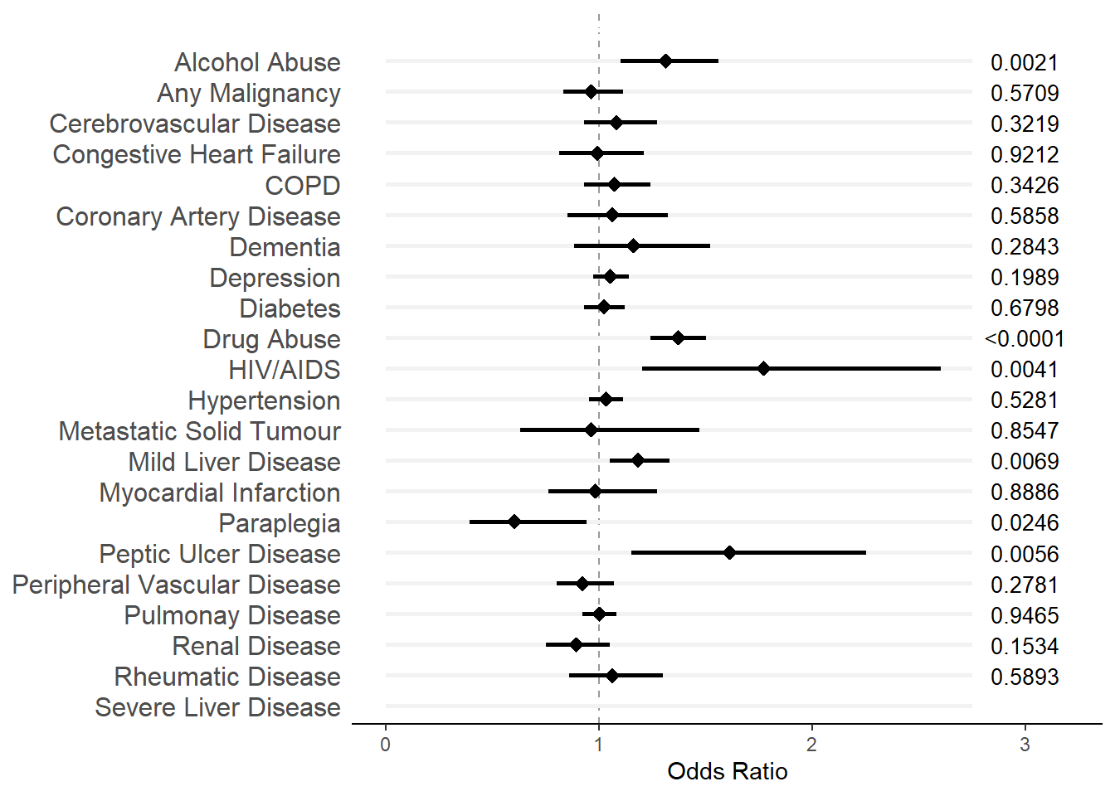
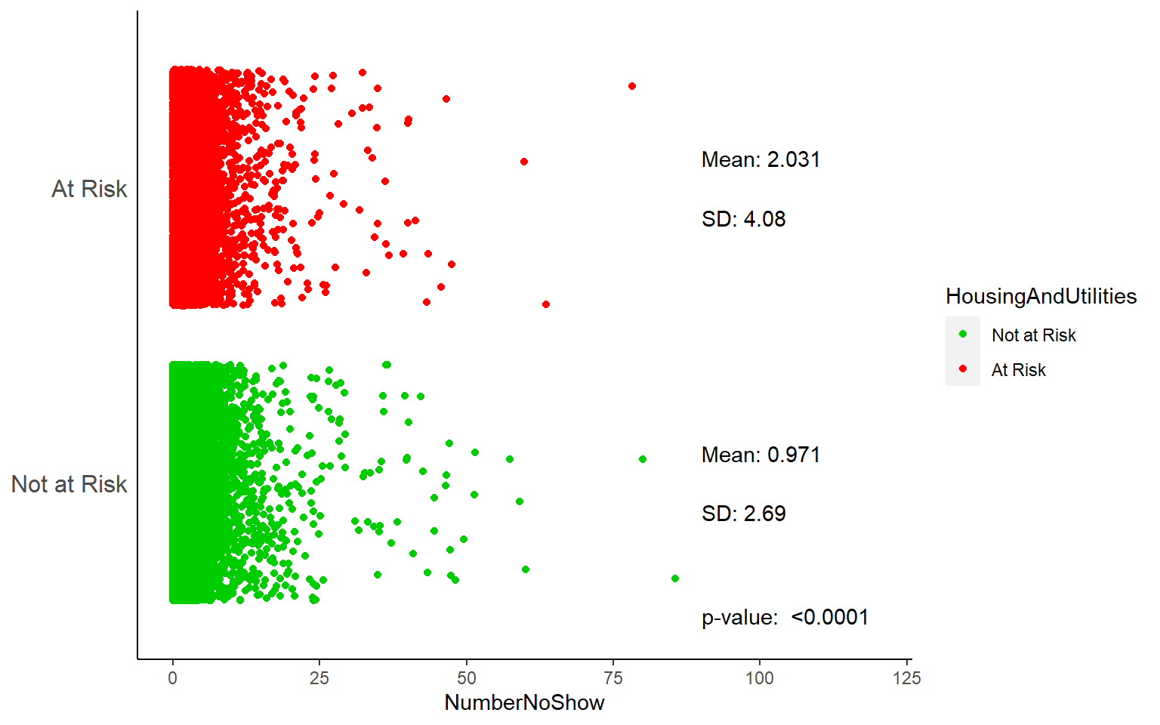
Deep Dive: Housing Instability
21% More Likely
3 or more ED visits
128% More Likely
To arrive at the ED by police

Slide 8
Thank You!

